Slide 1
Unisys CloudForte™ Overview
Presented by: Peter O’Donoghue, Kevin Worley, and Lakshmi Ashok

Slide 2

Introduction

Slide 3
Challenges of Cloud Adoption
Lack of understanding of the public cloud “shared responsibility” model
Difficulties in making a migration business case
Lack of an actionable scalable migration playbook
A lack of skills to operate workloads in the public cloud
Concerns around data ownership and security
Not fully understanding a FedRAMP package
Modernizing service management processes and tools to manage the public cloud
Paying for two environments simultaneously
Inflexible contracts
Providing a transparent invoice for cloud services that tie back to CLINS

Slide 4
Nuts & Bolts

Slide 5

Offering
A comprehensive managed services offering specifically designed for the management, governance, and migration of Amazon Web Services (AWS) public cloud environments.
Set of subscription services to securely manage and govern the use of AWS public cloud resources
Professional services that securely accelerates enterprise adoption of AWS cloud resources for agencies.
Envisioned and developed by seasoned Unisys cloud veterans to directly address the most critical challenges encountered by agencies at any stage in their journey to the cloud.

Slide 6
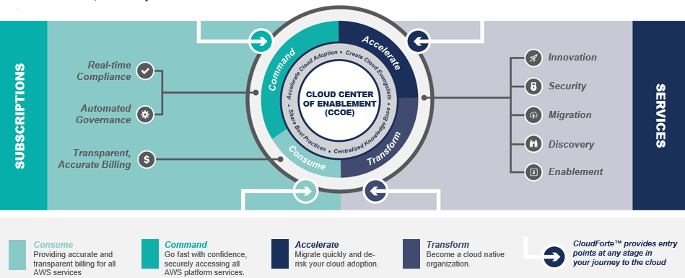
Services Snapshot
Includes both subscription-based platform services (Consume & Command) and expert professional services (Accelerate & Transform).
It is important to note that each service bundle contains features that enable individual consumption with no dependencies on other service bundles.

Slide 7
for AWS
DevOps
Account Setup
Financial
Management
Allows access to AWS catalog as it becomes GA in a governed compliant manner.
Solves financial oversight problems with AWS.
Accelerates AWS adoption.
Consume
CloudForte enables secure, governed access to native services
Service Catalog
Workload
Management
Backup/Restore
Log Aggregation
Cloud Native
Development Teams
Network,
Perf Monitoring
Security Monitoring
Command
Notification Service
Incident
Management
Asset Management
Change and Config
Management
Provides access to AWS cloud native services… with guardrails
Real Time Security
Compliance
Performance
Optimization
Accelerate
Migration
Accelerators
AWS Landing Zones
ATO
Accelerators
AWS Training/Certs
Transform
Org Change
Management/CCoE
Apps Modernization
Cloud Native
Applications
Data and Analytics

Slide 8
Consume & Command Services
Consume & Command subscription-based services include:
Fully compliant contract invoicing: Our fully- automated chargeback system takes all the guess work out of usage-to-Contract Line Item mapping.
Comprehensive metering and chargeback: Our financial management instrumentation covers all services offered by AWS on the day they are released for general availability.
Address ‘Shared Responsibility Model’: Scalable, cost effective and innovative security compliance services providing enterprise class management of AWS hosted workloads. Achieve ‘lights-out’ automation.
Access to cloud-native services with ‘guard-rails’: ‘Always on’ security policy engine ensuring workloads are always compliant. Discover and remediate drift in less than a minute.

Slide 9
Accelerate & Transform Services
Accelerate & Transform services include:
Enablement: Strategy, training, and organizational change management (OCM) services that helps Agencies successfully drive the mindset shift required by cloud adoption.
Discovery: Rapidly profile apps and workload portfolio and create a migration roadmap. Assemble a business case and identify adoption workstreams.
Migration: A repeatable approach to drive large scale migration to the AWS cloud that enables clients to measurably decrease time-to-market (TTM) and increase return-on-investment (ROI). Access AWS MAP discounts.
Security: Accelerates Authority of Operate (ATO) and provides compliance, advanced monitoring.
Process Renewal: Refactor your client’s management and governance processes to embrace ‘everything-as-code’ and public cloud. Bake DevSecOps into ITIL governance processes.
Modernization: Unisys is uniquely positioned to do the ‘hard yards’ of complicated application modernization

Slide 10
Selling CloudForte

Slide 11

www.unisys.com/inteliserve

